Slide 1
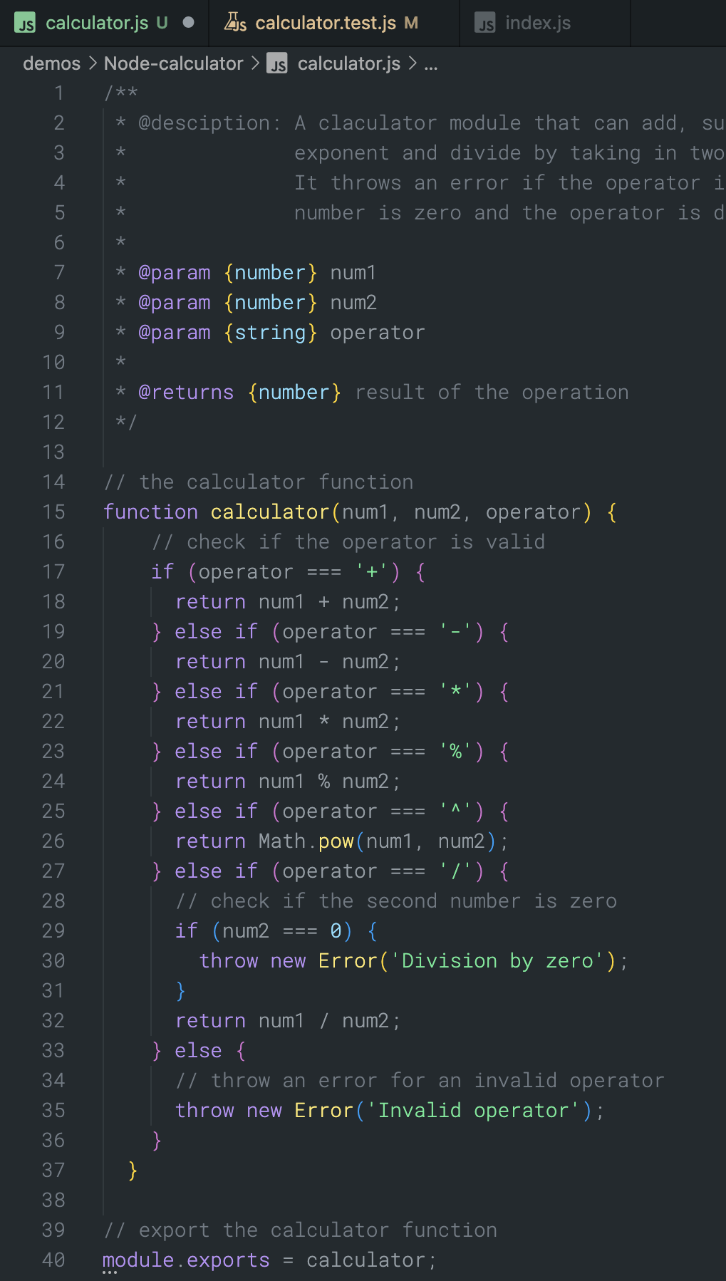


How Copilot Fulfills a Request
Apply several pre-model filters
Test for toxic language
Test for relevance (chat only)
Guard against prompt hacking
Copilot assembles context from tabs open in the code editor
Context / Prompt
Context / Prompt
Context / Prompt
N Suggestions
N Suggestions
N Suggestions
Proxy
OpenAI model
Copilot Agent
Apply several post-model filters
Code quality
Unique Identifiers (eg.: emails, IPs etc.)
Suggestion matching public code
Copilot
Notes:
NOTE: Slide is animated SPEAKER NOTES:
“What’s actually happening when Copilot fulfills a request?” (Press Key)
Copilot assembles context from tabs open in the code editor (Press Key)
Once context has been established in the code editor, the prompt passes via HTTPS to a proxy service. On the proxy, we apply several pre-model filters
First, we test for toxic language. Things like hate speech, sexual content, violence, and evidence of self-harm.
💬 CHAT ONLY: Second, we test for relevance. An intent classifier ensures the service only responds to questions about code and software development.
💬 CHAT ONLY: Third, we guard against prompt hacking. The service detects and blocks attempts to trick the model into returning service internals.
Assuming all tests pass, we pass the prompt to the large language model. (Press Key)
The model produces N responses, then deletes the prompt. Optional (For speaker knowledge): Your data will be shared if you are a copilot for individual user who has explicitly opted in to data sharing.
On the proxy again, we test for code quality and matching public code
Code quality (This includes a second code classifier and a security review to detect common vulnerabilities like SQL injections and path injections. Suggestions failing these filters are removed before reaching the user.)
Unique identifiers (eg.: emails, IPs, etc.)
Suggestions matching public code (optional based on enterprise policy)
(Press Key)
In the code editor, developers choose which suggestions to accept or reject
Note: Administrators can enable a filter that blocks all suggestions over 150 characters that match public code on GitHub.com (ignoring whitespace).

